Slide 1
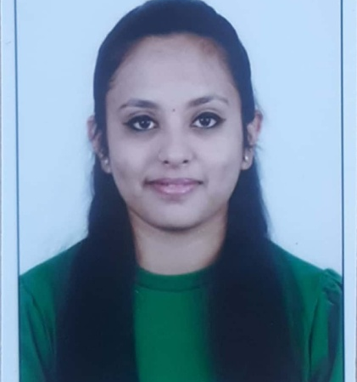



Bhoomika S
Analyst/Software Engineer
Bachelor of Engineering
Information Science : 2018 - 2022
Skills
Bangalore
Java 8 /J2EE | Java Basics, OOPS, Generics, Collections, Arrays, Loops, Lambda Exp, Stream API Junit, Mockito, Servlets
Spring core | IOC & Dependency Injection, Autowire
Spring REST | REST controllers, Implementation of GET, POST, PUT & DELETE, Bean Validation & Exception Handling, Testing Services, Controller & Repository layer
Spring Data JPA | Implement DAO layer using spring Data repositories, Transaction Management
Spring Boot Microservices | Spring Boot Starters, annotations, Messaging Service, Sync/Async comms, Swagger API specifications
Spring Cloud | Eureka, Netflix Ribbon, Feign Client, Hystrix, Zuul & Config Server
React | Components, Hooks, Event handling, Redux, Reducers, Testing using Jasmin & Karma
Angular | Components, Services, Modules, Routing, Forms & Validation, Testing using Jasmin & Karma
Database | MongoDB No Sql Advanced My SQL RDS Basics
UI Tech | HTML 5 & CSS 3,JavaScript, ES6 & TypeScript Reusable templates, Optimized UI Designed
Tools | Git, Postman, Maven, IDE,PMD,Checkstyle
Devops | CI/CD, Jenkins configuration, Build Pipelines, notifications, quality gate understanding
Add On skills | Communications, Team management. Peer learning
1rn18is033.bhoomi@gmail.com
+91 9611054161
A4
Hands on experience in developing web pages using HTML5, CSS3, Object Oriented Java script, JQuery, JSON, XML. Good understanding of Document Object Model (DOM) and DOM Functions.
Practical understanding of advanced Javascript concepts, such as Prototype, Closure, Scope Chain and Promise.
Proficient React developer with working knowledge on ReactJS.
Java Microservice Development knowledge using Spring boot and spring cloud framework on an intermediate level.
Implemented Nodejs and ExpressJs in case study and upskilling this knowledge continuously.
Experienced in practicing TDD based development using tools like Mockito, Junit, and also upskilling the knowledge continuosly.
MERN (Mongo, React, Express and Node) developer
Online Railway Reservation System
Completed end to end case study of Online Railway Reservation System along with JWT authentication, Swagger and payment testing using Braintree in MERN Stack. Material-UI and React Bootstrap used for user interface.
Recipe App
Completed a android app using java and xml in android studio where one can search a recipe of they wish and see the recipe and try .
Wedding Planner
By using the method of Database management system .Succesfuly implemented it by using back end(SQL) and front end tools(HTML, CSS) .
Completed Courses like C++ ,Sql for Beginners, web technologies in Udemy and Coursera
Check out my work on GitHub & Video Profile

